Slide 1




Fertility Treatment Involving a Donor – Eggs and Sperm
Dr Anne Clark
MPS, MBChB, FRANZCOG, FRCOG, CREI, APP
Medical Director, Fertility First with Genea

Slide 2
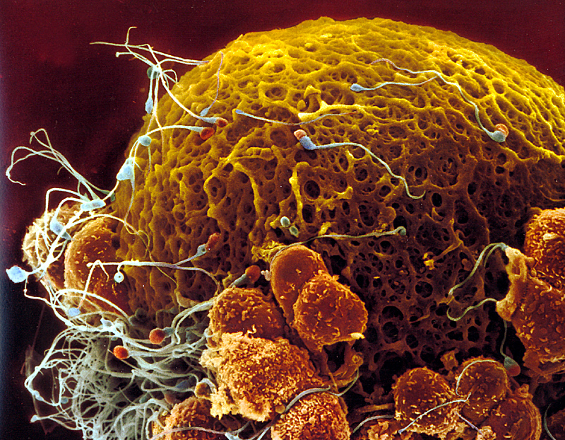
The egg is the largest cell in the human body and sperm are the smallest.
An egg and sperm contribute an equal amount of genetic material to a pregnancy.
You can fit 10 eggs on the head of a pin.

Slide 3
History
1884 Professor Pancoast of Philadelphia inseminated the wife of a sterile Quaker merchant with the sperm of the “best looking” of his medical students. The wife was chloroformed and never informed at her husband’s request. Reported 25 years later.
1953 The first successful pregnancy using frozen sperm reported
1954 DI first became public after the process was reported in The British Medical Journal
1964 First therapeutic sperm banks open in the USA and Japan
1984 First donor egg pregnancy born in Australia, only the third IVF pregnancy in the world
Notes:
Add a slice – of pic of egg and sperm from Slide 2

Slide 4
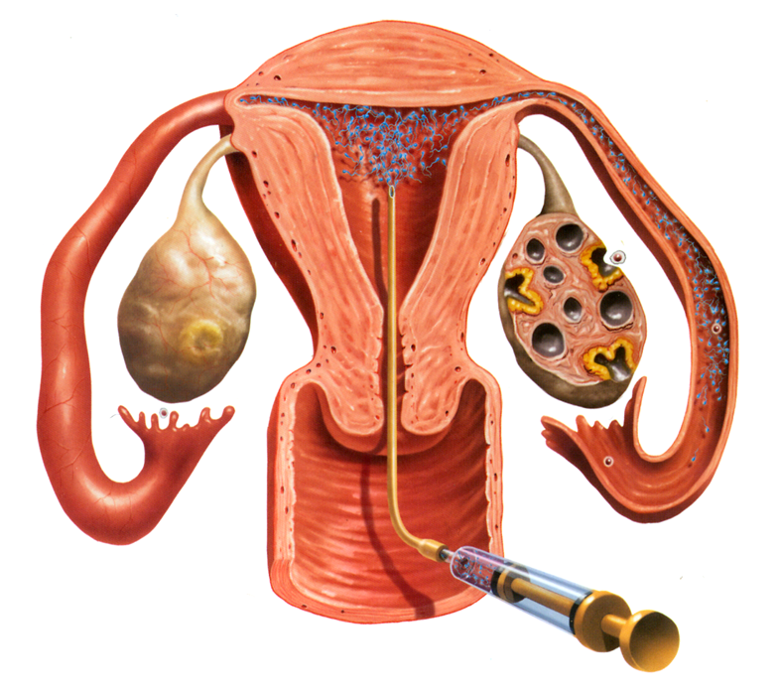
How common are donor sperm treatments and what is involved?
Donor sperm Intrauterine insemination cycles
3000 cycles a year in Australia clinics (ANZARD 2024)
Live birth rate 11% to 21% per treatment depending on the woman’s age
But only 3% if the woman aged 40 years or more
Requires at least patent fallopian tube
Track the woman’s ovulation for treatment on that day – millions of sperm inseminated as opposed to 10s to 100s
Embryo reaches uterus 3 to 5 days after fertilisation

Slide 5
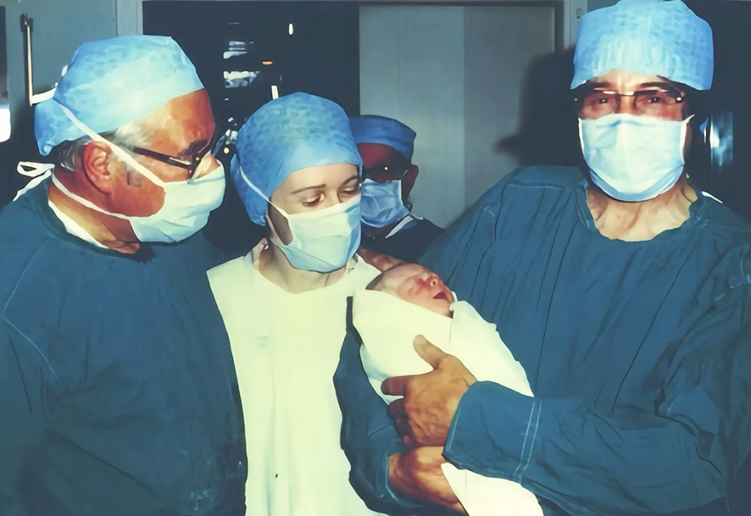
Donor sperm IVF cycles - if the woman has blocked fallopian tubes, intrauterine insemination has been unsuccessful, or the woman is older
IVF is a technology that is now 47 years old
IVF gives pregnancy rates 3 to 4 times higher than nature
IVF started as a treatment for tubal disease. Now more IVF cycles are done for male than female factors
Over 12 million babies have been born to date
Drs. Steptoe and Edwards and Jean Purdey at the birth of Louise Brown 25th July 1978. The world’s first IVF baby.
She and her sister have now had their own children naturally.

Slide 6
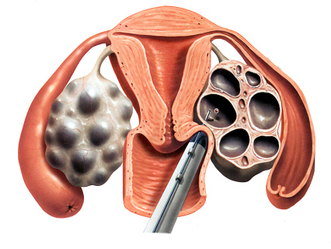
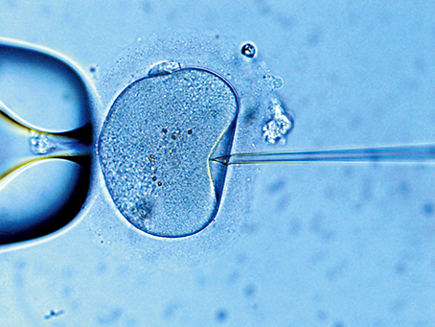
Donor sperm and egg donation IVF cycles
The woman injects drugs to encourage more than one egg to grow, collection of the eggs and fertilisation of eggs with sperm or freezing of donor eggs happens on the same day.
Resulting embryos are transferred or frozen 3 to 5 days later.

Slide 7
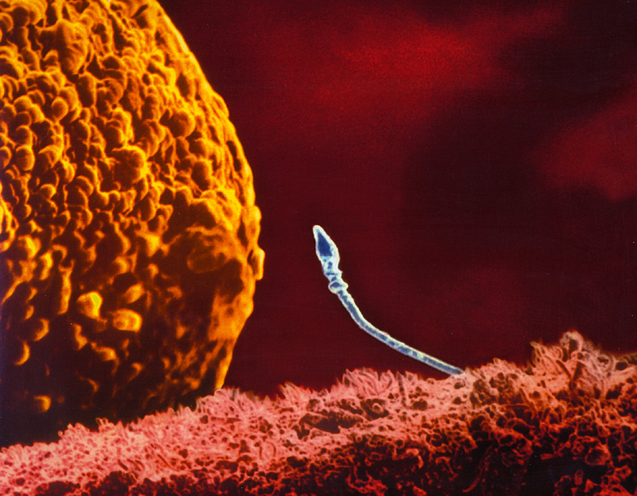
IVF is only an introduction agency for the egg and the sperm, it cannot override nature to make a baby
Fertilisation of the egg by the sperm and implantation of the embryo in the uterus are still up to nature!
They cannot be forced.
Hence IVF pregnancy rates will never be 100%.
An egg and sperm meeting in the fallopian tube

Slide 8
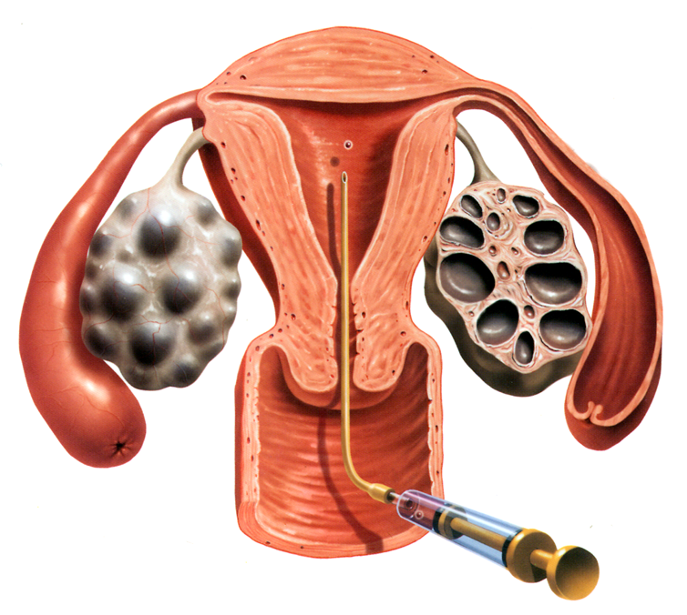
Embryo transfer in donor egg
(and donor sperm) IVF Cycles
3,800 donor egg transfer cycles with 30% live birth rate
– not significantly impacted by the woman’s age (ANZARD, 2024)
A simple, easy outpatient procedure similar to a cervical (PAP) smear being done.
Embryo placed 1 to 2 cms away from the top of the uterus.
Like placing an embryo in the middle of a jam sandwich – not an open cavity.
Pregnancy rates with donor sperm are affected by the woman’s age and the number of eggs collected.
Track the woman’s ovulation for transfer 3 to 5 days later, depending on the age of the embryo.

Slide 9
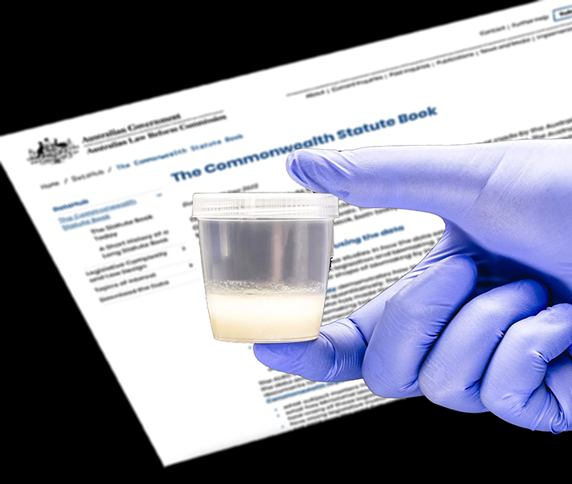
Australian requirements to be an egg or sperm donor
Applies to both Australian and International donors
Normal medical history and examination
Extended genetic carrier screen – tests for up to 600 medical conditions
Normal blood, and semen if appropriate, screening
Counselling, with partner if appropriate
Consent to Open Identity in the future and details held on a confidential Government register
Quarantine periods apply before can be used in a treatment cycle.
Notes:
Pic slice man and woman in late 20’s to mid 30s

Slide 10

Commercial trading in human eggs, human sperm or human embryos
All donations in Australia must be altruistic – only the donor's expenses can be covered by law. This includes overseas donors.
“Valuable consideration” for the donor by the clinic or the recipient, or a profit on the cost of the donor eggs or sperm on the part of the clinic, is a breach of the law.
A breach of the law, the Prohibition of Human Cloning ACT 2002 – SECT 23, is a criminal offence with a jail term of up to 15 years.
The law also applies to online sperm donors though much harder to police.
Notes:
A legal image slice

Slide 11

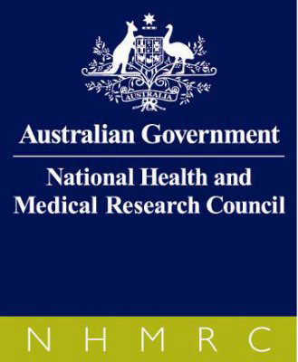

RTAC (FSANZ), NHMRC, NSW Government …
… the 3 bodies that ensure compliance with legislation and regulation
Any donor gametes used in this State and this country must comply with all their relevant requirements. Fertility units are assessed annually to ensure compliance.

Slide 12
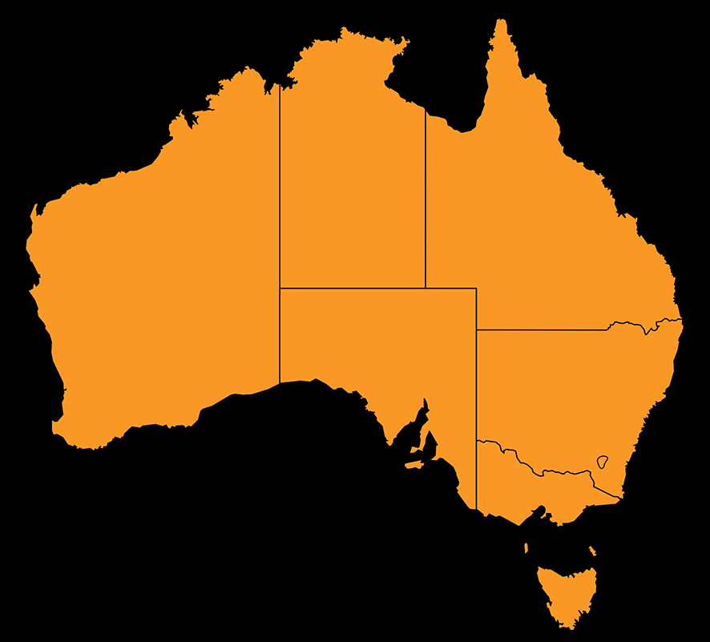
Different Australian states have different rules re family number per donor
Also, different clinics have different numbers of sperm donors available
In Sydney for example, depending on which clinic contact, responses will range from a waiting list of 3 to 6 months, to 100 sperm donors immediately available at Fertility First May 2025 data
NT(10)
QLD(10)
WA(5)
SA(10)
NSW(5)
ACT(10)
VIC(10WW)

Slide 13
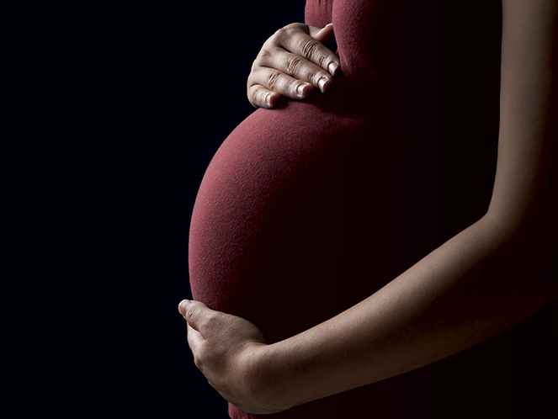
Outcomes of resulting children
There is rigorous screening of sperm and egg donors to avoid adverse genetic and health impacts on the child.
Children conceived through sperm donation have a birth defect rate that is only 20% of the general population
Essig et al, 2007
Donor age restricted to 35 years
or younger to reduce adverse
parental age effects.

Slide 14
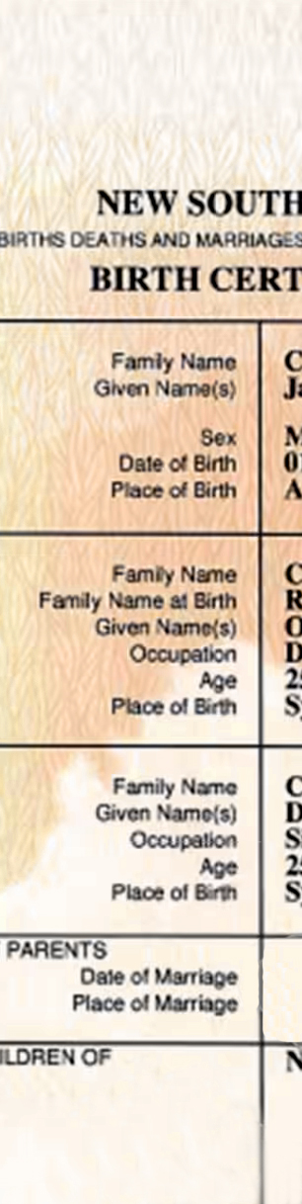
Who are the legal parents ?
In Australia, a sperm donor, including a known donor, is not eligible to seek parental rights or be held responsible for parental obligations unless he is named on the child’s birth certificate.
For egg donation, the birth mother is the legal mother, irrespective of the genetics.
Connection website and Facebook sperm donors are less protected – no consents etc. Donors who require “natural conception” in particular can be held liable for child support into the future – same as a “one night stand”

Slide 15
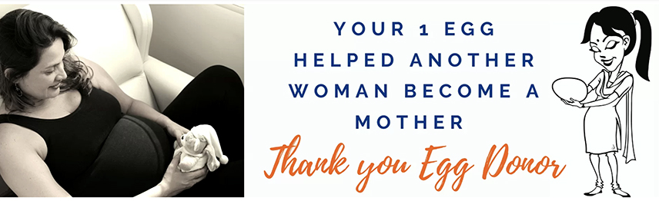
Why do men and women become donors?
Donors have to do a lot more than just supply sperm or eggs – fill out lengthy questionnaires, research their family histories, frequent physical examinations (including needle sticks), adopt a life style consistent with clinical requirements, and if an egg donor, take injectable drugs and have a minor surgical procedure.
Essentially to help other people to have a family, often because they have become aware of the struggles someone they know is having.
Egg donors in particular can find it very empowering.
They do “ worry if things haven’t turned out well for the child” and “they are not born into a happy family.”

Slide 16

What about the children?
All the research has shown that the makeup of families – the number, gender, sexual orientation, gender identity and biological relatedness of parents – matters less than previously thought.
“The presence of a father, or a mother or two parents is not essential for children to thrive.”
“What matters most for children is the quality of relationships within their family, the support of the wider community and the attitudes of the society in which they live.”
Professor Susan Golombok and her team have been researching and following donor families from birth into adulthood for 49 yrs

Slide 17
Should a child be told of their donor origins? Yes
We have reached a time when secrecy about donor conception cannot be guaranteed
(Online genealogy databases)
Nor is it recommended as being in the best interests of the child’s psychological well being.
Learning about one’s donor conception later in life can be shocking and profoundly disturbing.
Many children have already suspected or thought they were adopted prior to being told.

Slide 18

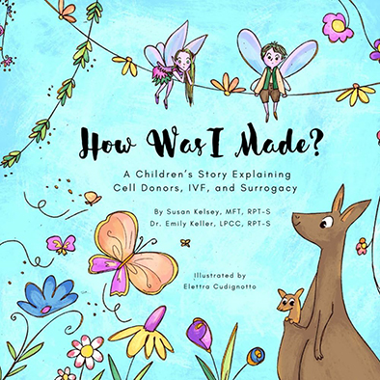
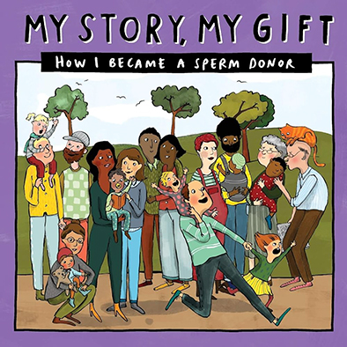
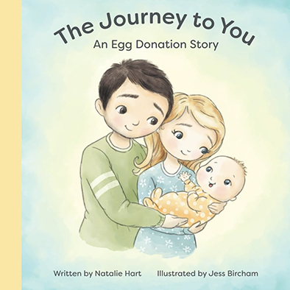
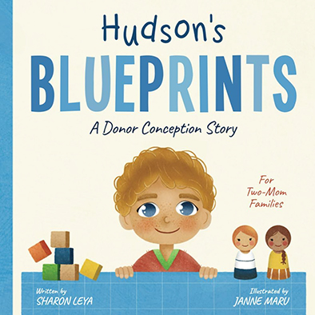
When is the ideal time to tell a donor conceived child of their origins?
As early as possible. This helps the child integrate the information into their developing identity and minimises stress and confusion later.
Children often want to know where babies come from when they are about 3 to 4 years old, so this is the recommended age if not part of the child’s family story already.
Keeping a secret about how the child was created can make the child and others think you are ashamed of having a baby with the help of a donor. Later discovery also undermines trust in family relationships.

Slide 19
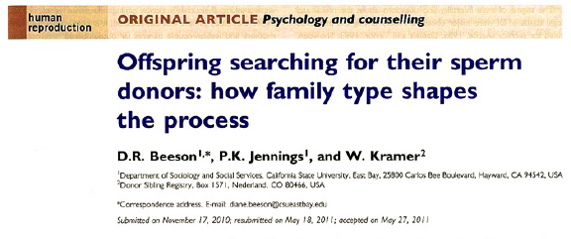
Though a donor’s details are held on a Central Register and at the treating clinic in perpetuity for a donor conceived person to access at age 18, parents are not required by law to tell their children they are donor conceived, so they might be unaware they can find their donor.
Knowing about their donor is important to some children and adults – to gain a better understanding of who they are, where they come from, and where they fit in. Some have no interest.
In many cases the children are more interested in their donor siblings than the donor.

Slide 20
Treatment timeline: summary of donor recipient process
Make appointment with clinic – history, examination and screening bloods
Genetic testing of partner of donor recipient
4 weeks
Book and complete a counselling appointments x 2
Follow up with doctor to discuss results before contact with Donor Team
Speak with Admin. Team re costs and early superannuation release (if required)
2 - 4 weeks
Choose donor and get clearance from donor bank
Donor allocation completed – genetic counselling
2 - 4 weeks
If donor egg shipment date advised. Donor sperm already on site
Treatment cycle started
2 - 3 months

Slide 21
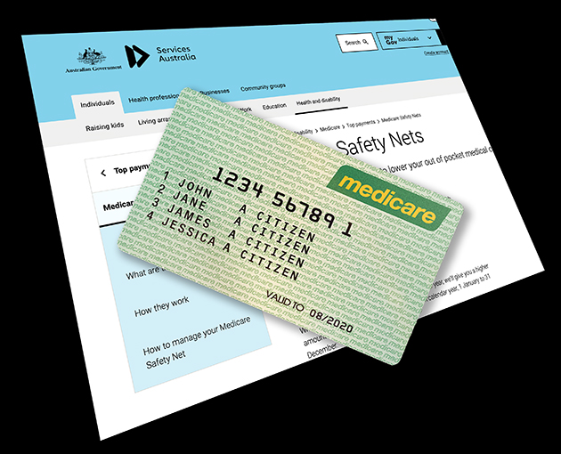
Costs
Out of pocket costs if have access to Medicare. Cost of donor eggs and donor sperm not included as not Medicare rebatable
Intrauterine insemination $2,000 + donor sperm cost
Donor egg $5,881 + donor egg cost
IVF with donor sperm $4,500 + donor sperm cost
Cost of eggs varies on number chosen >US$10,000 - guarantees apply
Donor sperm - $1,500 to $2,000
Super can also be used to cover out of pocket costs.

Slide 22
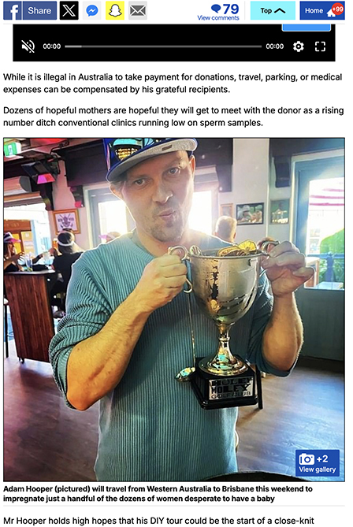
Sperm donors sourced from Connection Websites and Facebook
Pros:
Less costly, meet the donor, more immediate treatment if clinics have donor waiting lists
Cons:
Absence of genetic and other screening including for sexually transmitted diseases
Absence of counselling means no psychological screening, boundaries not set and consented to before conception
No control over family numbers
No legal protections
Contact for child in future more uncertain
For donor – No legal protections – unwilling legal father - no control over contact with child into the future
Mr Hooper’s website has more than 16,000 members

Slide 23
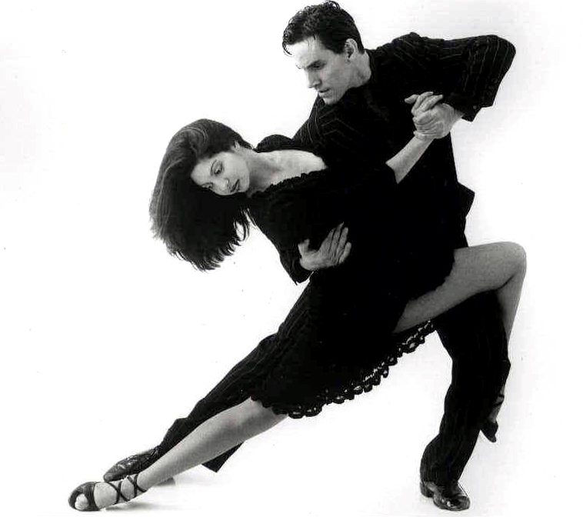
Though the chance of pregnancy depends on the treatment type and sometimes the woman’s age ‘It takes two to tango’
Attention needs to be paid not just to the recipient but also the other half of the baby to maximise the chance of pregnancy with donor eggs or sperm.

Slide 24
As even a mild reduction in fertility parameters, particularly in combination, can reduce the chance of pregnancy, so it is very important to ensure that the fertility of the recipient or recipient’s partner is also at it’s best.
Number of
mild factors
0
1
2
3
Typical
monthly chance
20%
5%
1%
0.2%
Estimated time
to a pregnancy
4 months
2 years
7 years
40 years

Slide 25
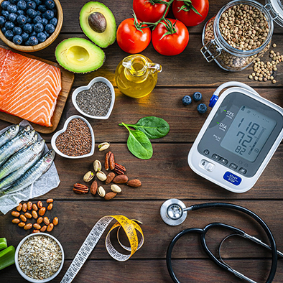

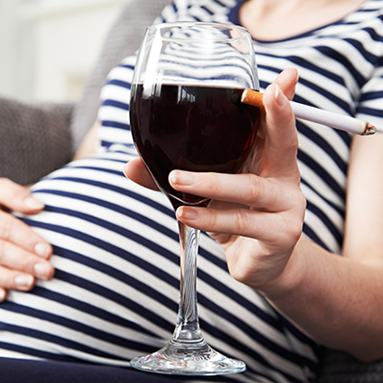
Optimise preconception health – Women
Important for egg donors and recipients of donor eggs and donor sperm

Slide 26
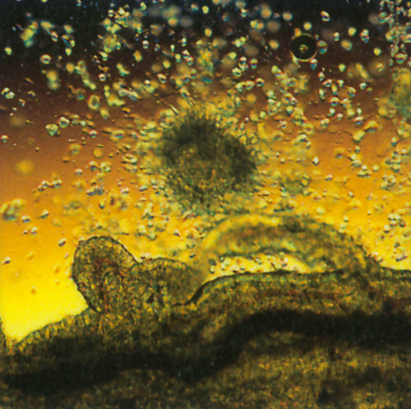
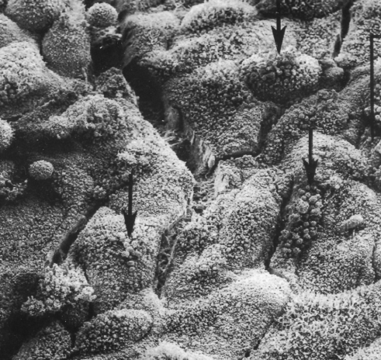
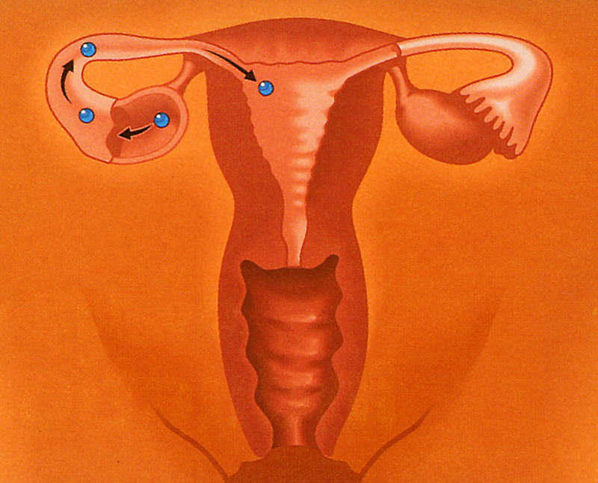
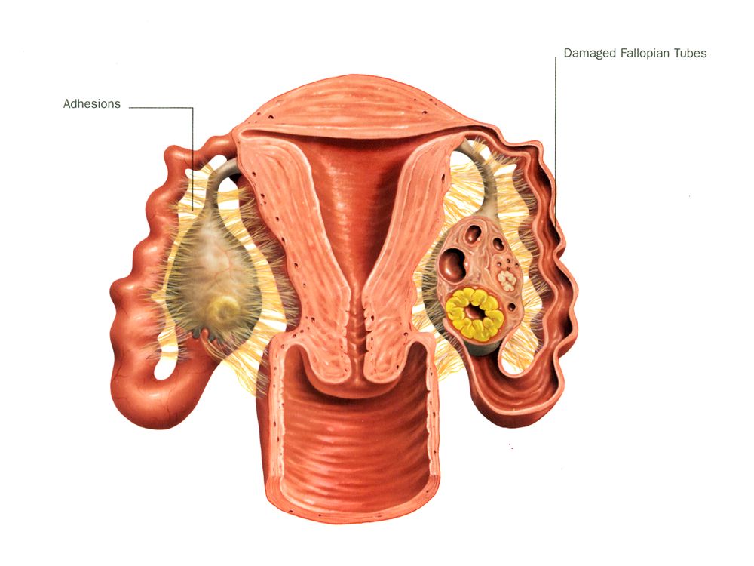
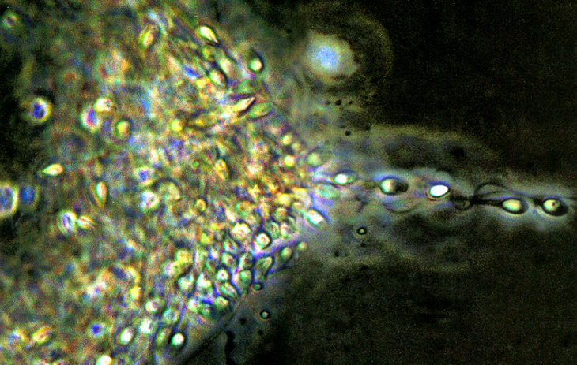
In a woman for pregnancy to occur …
1: Mature healthy egg
ovulated Into the
fallopian tube
2
3
1
3: Receptive endometrial lining
of 6mm or more with no
uterine polyps or adhesions
4
2: At least one normal
fallopian tube. Fertilisation
occurs in the outer part
of the tube
4: Sperm able to swim through
cervical mucous
e.g. no sperm antibodies

Slide 27
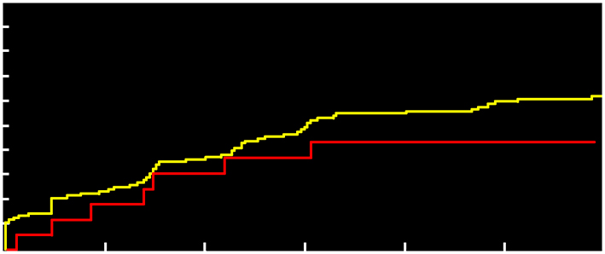
Vitamin D:
Women’s time to conception for pregnancy by serum 25(OH)D status
Percent conceived
100
90
Fung. Vitamin D and Fertility. Fertil Steril 2017*
80
70
Sufficiency
60
50
40
At risk of inadequacy or deficiency
30
20
10
0
0
1
2
3
4
5
6
Months from baseline
Low maternal Vitamin D levels in pregnancy are linked to a higher risk to the baby of weaker bones, asthma, Type 1 diabetes, autoimmune disease, neurodevelopmental issues e.g. ADHD and autism and multiple sclerosis in later life.
Lower maternal Vitamin D levels in pregnancy also increase the risk of recurrent miscarriage, pre-eclampsia, gestational diabetes, preterm birth and low birth weight babies in the mother.**
*Adjusted for age, race, BMI category, alcohol consumption, smoking status and physical activity score. At risk of inadequacy or deficiency is defined as serum 25(OH)D <50nmol/L; sufficiency defined as serum 25(OH)D >50nmol/L. **Chien et al, Nature 2024
Notes:
RAY A NUTRITION SLICE

Slide 28
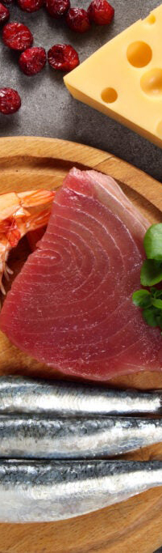
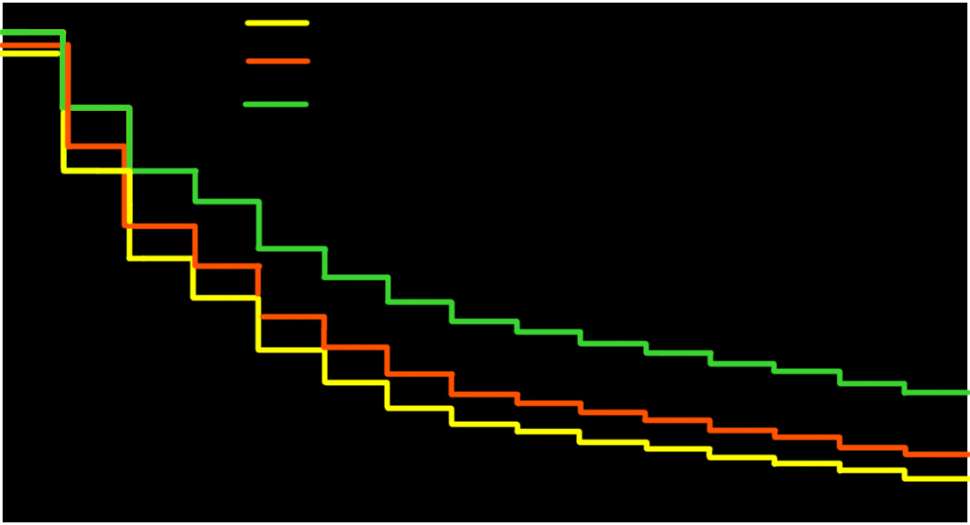
Iodine: adjusted probability for not becoming pregnant
Women who are iodine deficient are 46% less likely to get pregnant over each menstrual cycle compared to women who have sufficient iodine
Mills et al, Hum Reproduction, March 2018
Percent Remaining
Non-Pregnant
1.0
Iodine to Creatine Ratio <50mg/g
50 mg/g <= Iodine to Creatine Ratio < 100 mg/g
Iodine to Creatine Ratio >= 100mg/g
0.75
0.55
0.25
0
0
1
2
3
4
5
6
7
8
9
10
11
12
13
14
15
Time to Pregnancy in Menstrual Cycles

Slide 29
Lifestyle factors – Iodine levels
Iodine deficiency in pregnancy is the commonest cause of mental retardation in the world. Severe deficiency causes cretinism.
Milder deficiencies are associated with an irreversible decrease in the child’s IQ of 10 to 15 points.
It is also linked to autism.
Iodine deficiency not only causes infertility but increases the risk of miscarriage and pregnancy complications, including stillbirth.
57% of women seen at Fertility First are found to be iodine deficient at their first appointment.
Iodine is found in iodised salt, milk, dairy products and white fish.
Allen et al., 2006

Slide 30
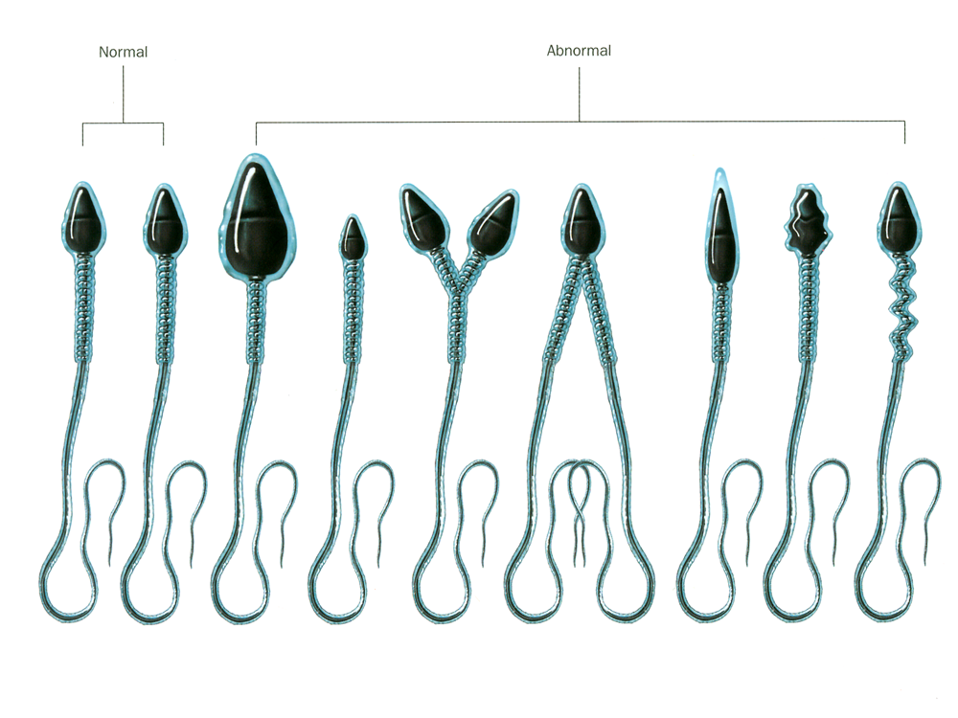
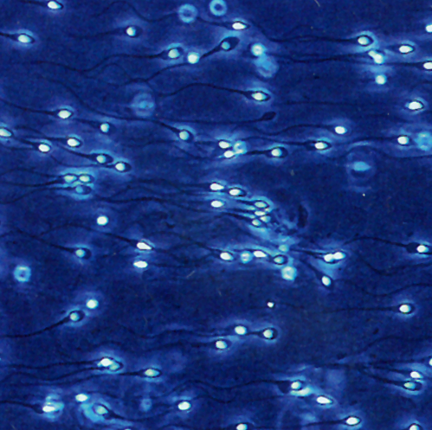
In a man for pregnancy to occur he needs to produce a certain number of normal, moving sperm
Normal sperm parameters:
>15 million per ml
>40% motile – 32% progressive
>4% normal forms
Sperm can live in the female reproductive tract for up to 5 days.
An egg only lasts 1 day after ovulation.
Normal and abnormal sperm.
Shape is a “key to the door”
not a “contents” issue

Slide 31
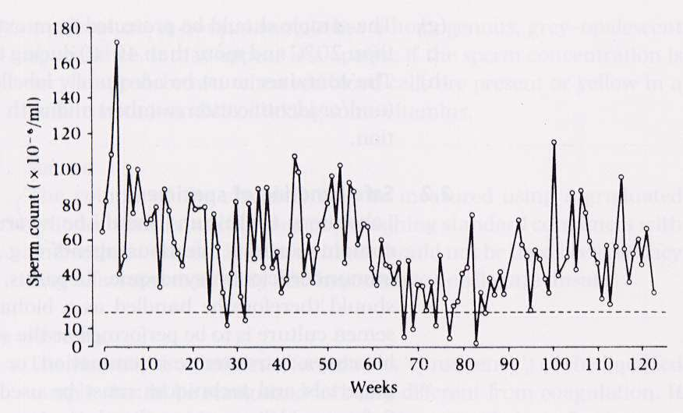
A man’s sperm concentration or count varies a lot over time
Ref: W.H.O. , 1999 One man’s weekly count over 2 years

Slide 32
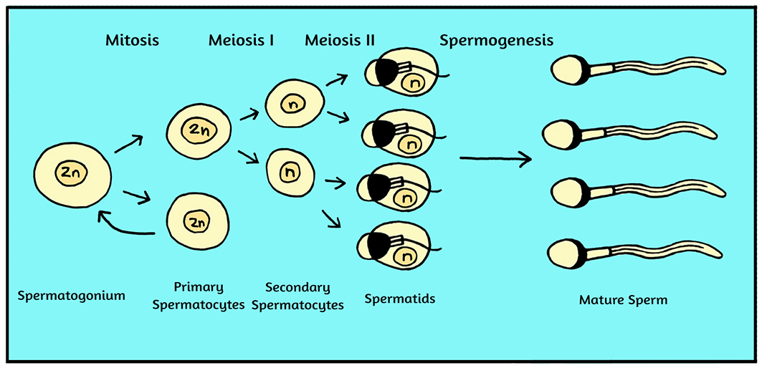
Just as with a woman’s eggs, a man is born with all the cells he will have in his life to make sperm. The difference is that unlike eggs, sperm cells can divide multiple times over a man’s lifetime to make more sperm.
A man makes over 525 billion sperm cells during his lifetime. That many replications of the germ cells can lead to increased DNA errors.

Slide 33
As the DNA errors in the sperm get repeated and added to over time as a man ages, fertility is reduced and the risks of miscarriage and birth defects in the child increase.
Hence upper age limits on sperm donors and the importance of assessing men's sperm prior to donation or a donor egg treatment.
Lifestyle factors such as smoking, poor nutrition and too much alcohol increase those risks.

Slide 34
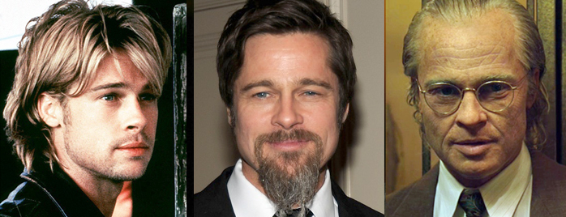
Not all sperm are created equal …

Slide 35
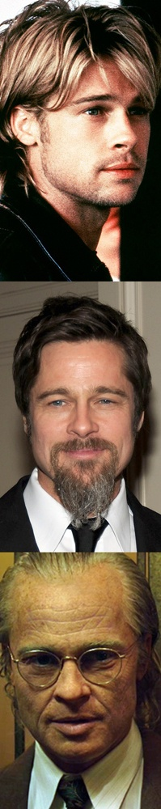
As a man ages, DNA damage in sperm can increase, reducing the chance of natural or treatment conception unless treated first
Time to Conception for a
25 year old Woman vs. Male Partner’s Age
Time to
Pregnancy
(months)
4x longer
25
20
2x longer
15
10
months
5
4.6
6.2
6
11.5
22
months
months
months
months
months
months
months
months
0
<25
25-30
30-35
35-40
>40
Male Partner’s Age (Years)
Hassan et al, F&S 2003, 2006
Notes:
To illustrate like to show a couple of studies

Slide 36
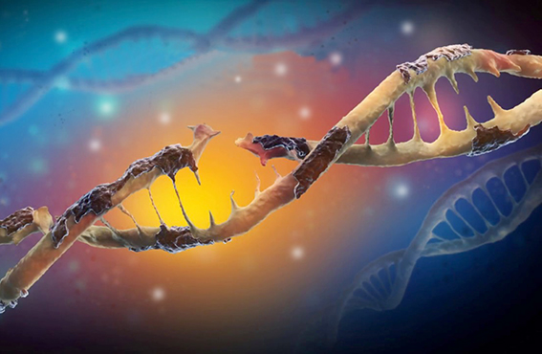
Lifestyle changes and oral antioxidants have been shown to be very effective in reducing sperm DNA damage but take 6 to 8 weeks to be fully effective

Slide 37
In conclusion:
Modern technology combined with donor eggs or donor sperm enables many more people the option of having a child
Despite their disparity in size both eggs and sperm contribute an equal amount to a pregnancy
Attention needs to be given to the partner of the recipient to maximise the chance of pregnancy.
It is important that the child is told early of their origins to maximise positive family relationships.
Outcomes for donor conceived children into adulthood are maximised by happy supportive families and when told donor conceived.
An egg and sperm meeting in the fallopian tube

